Slide 1
Theoretical perspectives of sociology
Ms. Shahtaj and Ms Aqsa Fayyaz
Lecture-2
Sociology
FAST NUCES

Slide 2
Learning outcomes
Learning different theoretical perspectives of sociology
Learning how these perspectives are applied in today’s world

Slide 3
1. Functionalism
1.The central idea of functional analysis is that society is a whole unit, made up of interrelated parts that work together.
2. Very important for any society to stay stable and continue

Slide 4
Functionalism
. Emile Durkheim also viewed society as being composed of many parts, each with its own function. He said that when all the parts of society fulfill their functions, society is in a “normal” state. If they do not fulfill their functions, society is in an “abnormal” or “pathological” state. To understand society, then, functionalists say that we need to look at both structure (how the parts of a society fit together to make the whole) and function (what each part does, how it contributes to society).

Slide 5
Functionalism
3. The main concept in functionalism is solidarity, indicating how well the different elements of the society can work together to attain the main goal of continuity of the society
Example: Family and the divorce rate

Slide 6


Slide 7


Slide 8
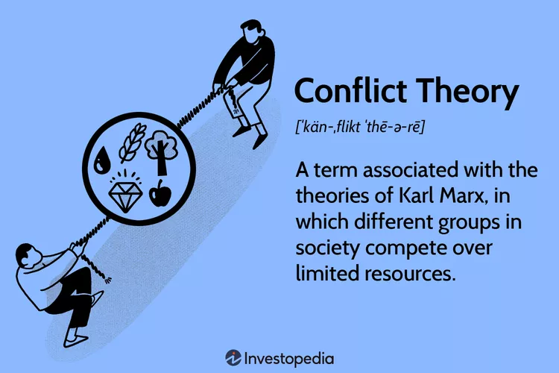
2. Conflict theory

Slide 9
Conflict theory
Conflict theory provides a second perspective on social life. Unlike the functionalists, who view society as a harmonious whole with its parts working together, conflict theorists stress that society is composed of groups that compete with one another for scarce resources.
Karl Marx and Conflict Theory Karl Marx, the founder of conflict theory, witnessed the Industrial Revolution that transformed Europe. He saw that peasants who had left the land to work in cities earned barely enough to eat. Things were so bad that the average worker died at age 30, the average wealthy person at age 50. As he did so, he developed conflict theory. He concluded that the key to human history is class conflict.

Slide 10
Conflict Theory Today
Many sociologists extend conflict theory beyond the relationship of capitalists and workers. They examine how opposing interests run through every layer of society—whether in a small group, an organization, a community, or an entire society.
For example, when teachers, parents, or the police try to enforce conformity, this creates resentment and resistance. It is the same when a teenager tries to“change the rules” to gain more independence. Throughout society, then, there is a constant struggle to determine who has authority or influence and how far that dominance goes (Turner 1978; Piven 2008; Manza and McCarthy 2011).

Slide 11
3. Symbolic Interactionism
Symbolic interaction theory analyzes society by addressing the subjective meanings that people impose on objects, events, and behaviors.
Although symbolic interactionism traces its origins to Max Weber's assertion that individuals act according to their interpretation of the meaning of their world, the American philosopher George Herbert introduced this perspective to American sociology in the 1920s.
Example: Why would young people smoke cigarettes even when all objective medical evidence points to the dangers of doing so?
Example:

Slide 12
VIDEO LINK
https://www.youtube.com/watch?v=fGJgPugeOFU

Slide 13





Applying Symbolic Interactionism

Slide 14
4. FEMINIST PERSPECTIVE
First coined in 1837 by French philosopher, Charles Fourier (as féminisme).
Movement of women
The philosophy that men and women should be politically, economically, and socially equal; organized activities on behalf of this principle.
It works for equality, not for female’s superiority.
It focuses on social, economical, political rights of female.
Historically, women were not treated well, were treated as slaves etc.
The view that biology is not destiny, that stratification by gender is wrong and should be resisted, and that men and women should be equal—met with strong opposition, both by men who had privilege to lose and by women who accepted their status as morally correct.

Slide 15
3 WAVES OF FEMINISM:
2. Second wave of feminism: (1960’s)
1. First wave of feminism: (mid 19th to early 20th century 1850’s to 1910)
The second wave feminism movement took place in the 1960s and 1970s and focused on issues of equality and discrimination.
The Second Wave focused more on both public and private injustices.
Movement against domestic violence (heavily criticized because it was only for upper class white women)
Based on political rights mostly

Slide 16
4. Fourth wave of feminism (2005)
3. Third wave of feminism (a big Hit)
It was a big hit as it addressed the limitations of second wave of feminism.
a) It also focused on the rights of non-white women as well.
Based on use of social media (it was highlighted)
a) Justice for women
b) oppose sexual harassment
c) against body shaming (objectifying her in media)
Notes:
Dona Haroway: Cyborg Manifesto (technology will dissolve gender discrimination)

Slide 17
Devaluation of Feminine in today’s world
:
People are often unaware that they make these evaluations, but if you listen carefully, you can hear them pop up in everyday speech
In general, with masculinity symbolizing strength and success, a higher value is placed on things considered masculine.
Femininity, in contrast, is often perceived as weakness and lack of accomplishment.
.

Slide 18
THANK YOU

